Slide 1
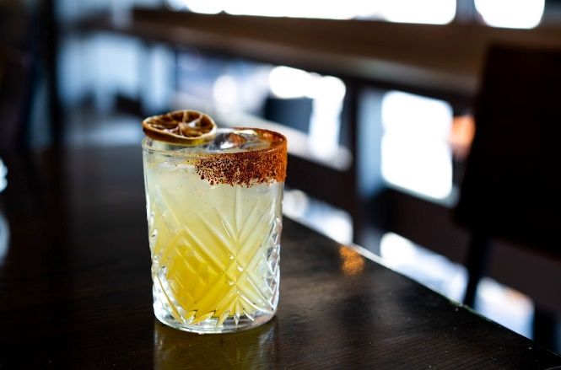
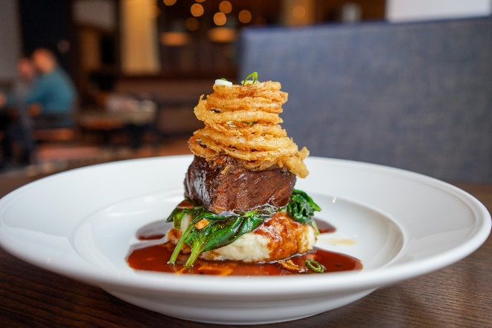
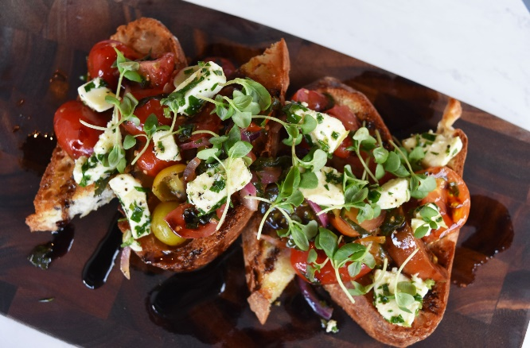

Slide 2
Why CIRCA at Foggy Bottom?
We understand that trusting a restaurant when you’re planning a large event can be a leap of faith. Our goal is to exceed all expectations for you and your guests by making it easy to plan and execute. Having been in the Metro DC and Northern Virginia markets for over a decade, we have built our trust organically and provided consistent quality you can count on with a value proposition that is unmatched by our competitors. We look forward to hosting your next event and making sure you and your guests come away smiling and eager to return!

Slide 3
Simple Booking
Your time is valuable, so we’ve gone to great lengths to take the guesswork out of booking your next event. Our goal is to streamline the process in to four simple and upfront steps. Once you’re booked we’re ready to go!
What type of event and when?
Pick a spot
Select a menu
Close contract details

Slide 4
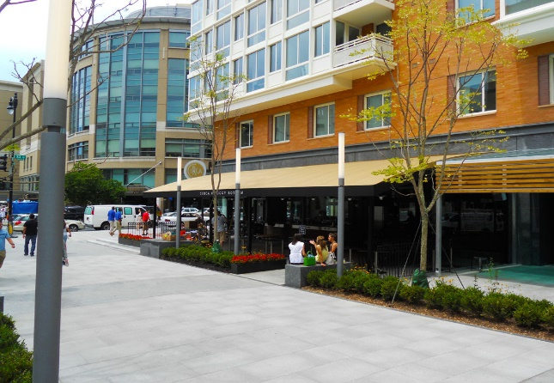
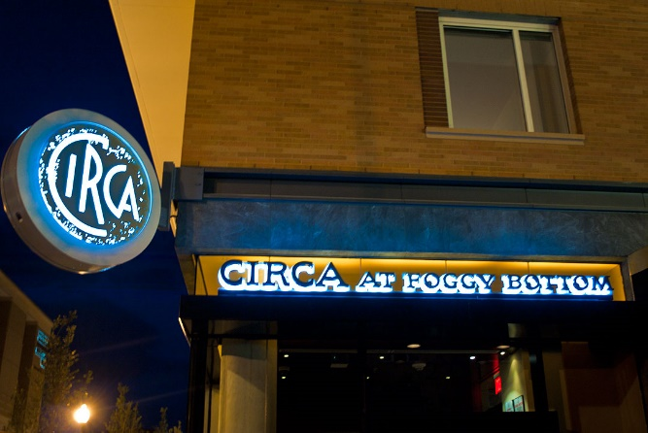
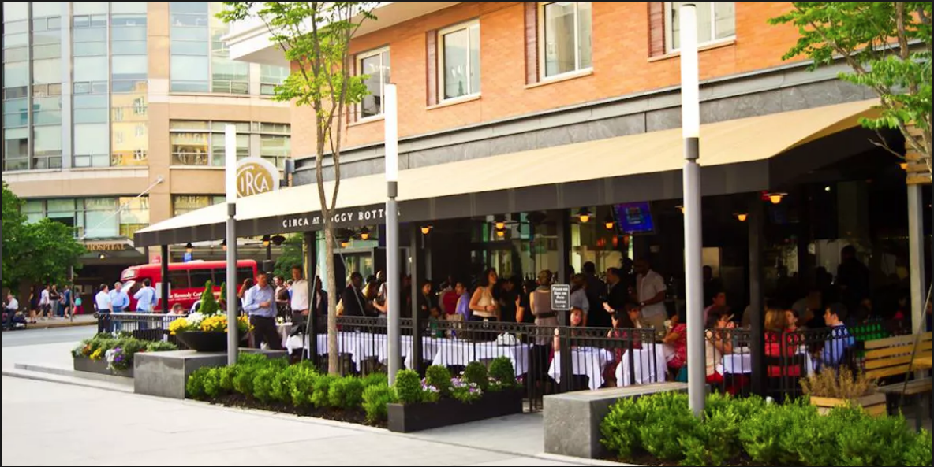
The Location
CIRCA at Foggy Bottom is conveniently located across the street from the Foggy Bottom Metro entry at the corner of 23rd NW and I St. We are on the George Washington University’s historical campus and directly across the street from the GW Hospital.
We are also your ideal location for a pre or post Kennedy Center dining experience. Kennedy Center’s free shuttle departs directly across the street from CIRCA every 15 minutes from 9:45 a.m.-11:30 p.m. Monday-Thursday, 10 a.m. – midnight Fridays and Saturdays, noon-11 p.m. Sundays, and 4-11 p.m. on Federal Holidays.
We’re a few blocks away from both the IMF, the IFC, and the Department of State making CIRCA the ideal spot to host a business lunch or a gathering for dinner.

Slide 5
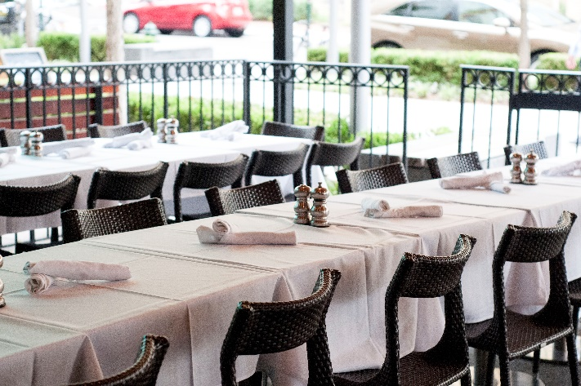
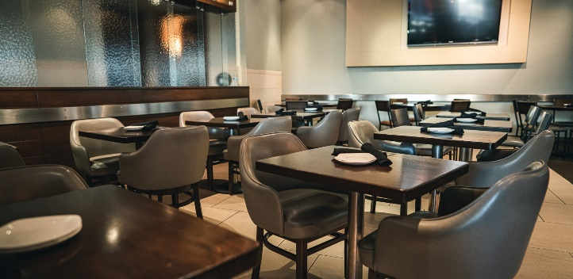
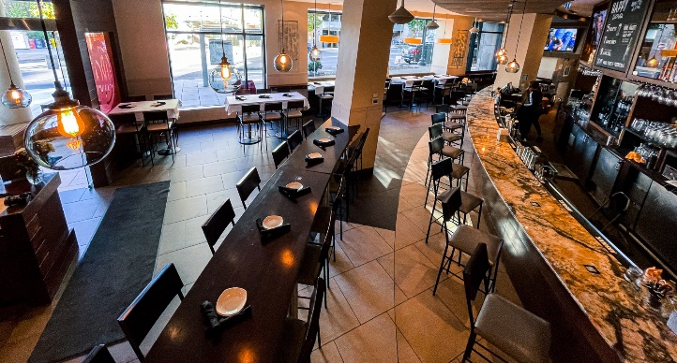
The Space
CIRCA at Foggy Bottom offers an expansive patio and bar area to serve a variety of large party and happy hour event purposes. Each event space has possible floorplan options and customizations
Pick the spot that works best for your function:
Patio
Hightops
Main Dining Room

Slide 6
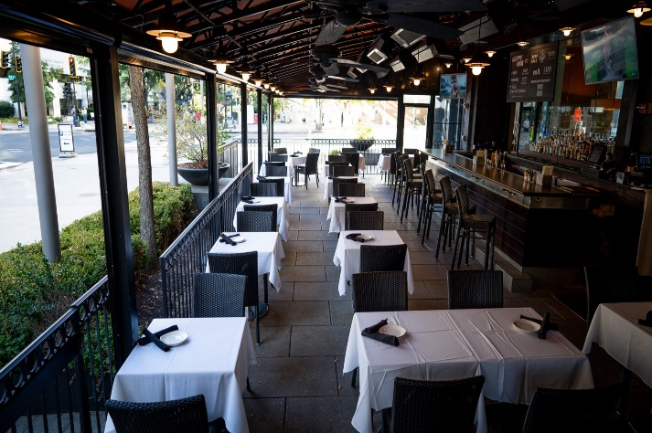
Patio
Our patio is ideal for an after-work happy hour or large celebration. With a maximum capacity of 150 people, it can be sectioned off to provide a more intimate space for smaller parties. The patio also features its own 15 seat bar that allows for a convenient, full service experience.
The patio is covered by an awning. We also have gas heaters and side panels that fully come down to winterize the patio during the fall and winter seasons.

Slide 7
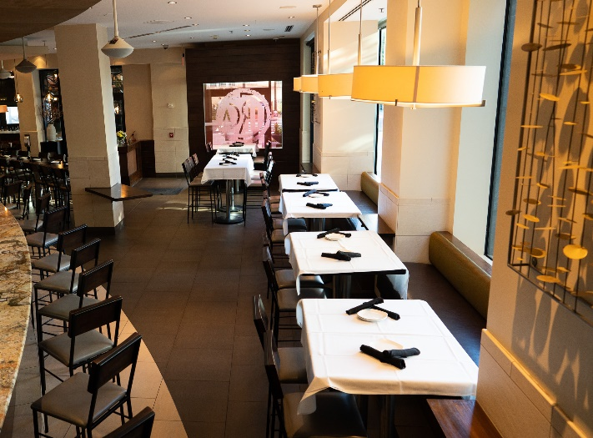
Hightops
Our hightops, located in our main bar area, create great spaces for mingling and networking. The six hightops span the length of our bar and are nestled under our expansive side windows.
Depending on the size of your group, we can customize the space to accommodate up to 40 guests for a cocktail event.

Slide 8
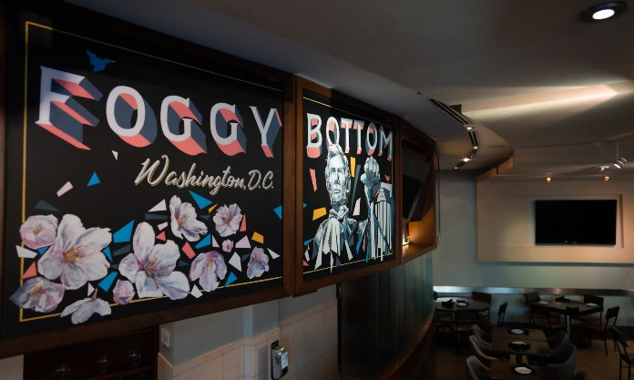
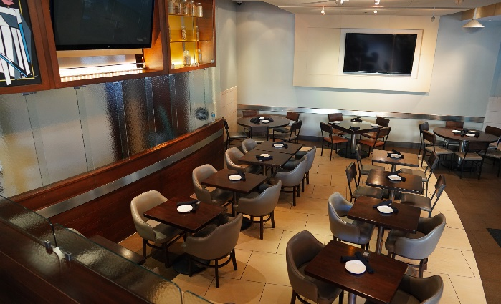
Main Dining Room
The main dining room is perfect for small events of up to 12, while the patio is capable of seating up to 30 - 55 guests. CIRCA at Foggy Bottom is well equipped with a variety of set banquet style menus in all price points as well as the capability to build buffets and cater outside events.

Slide 9
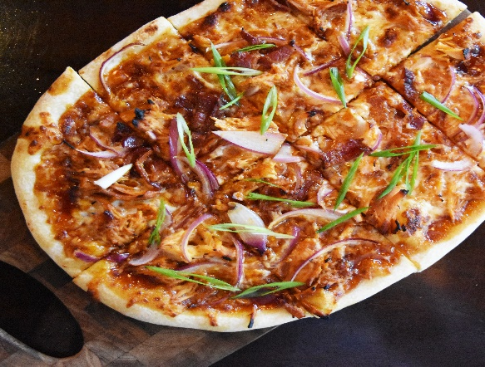
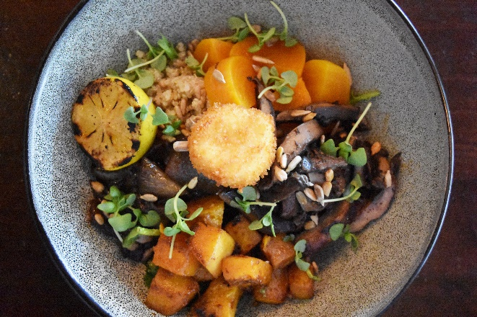
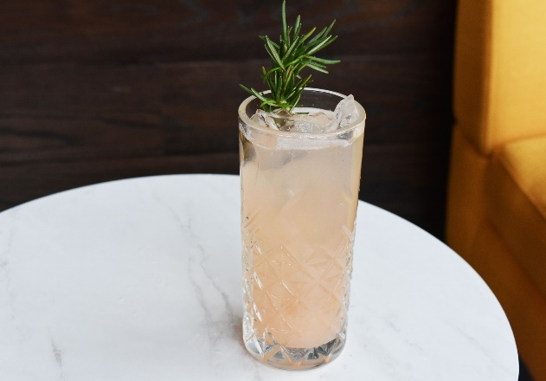
The Food & Beverage
At its heart, CIRCA is an American Bistro. Our menu is indicative of our commitment to the classics as well as new fare that speaks to our locations specific flavors and desires.
We offer a variety of pre-selected menus at different price points for lunch, brunch and dinner. Each menu is crafted to include a fantastic variety of dishes at a price point within your budget. Also available are a variety of wines to choose from and pre-select for your party to keep the good times rolling from the moment you walk in the door.
Not interested in a sit down dinner? No problem, we also offer delicious appetizer platters for sharing and passable hors d'oeuvres for cocktail parties and happy hour type events.
Every dish, every cocktail and every guest that comes to CIRCA deserve nothing but the best in quality and we are always focused on delivering that experience to our guests.

Slide 10
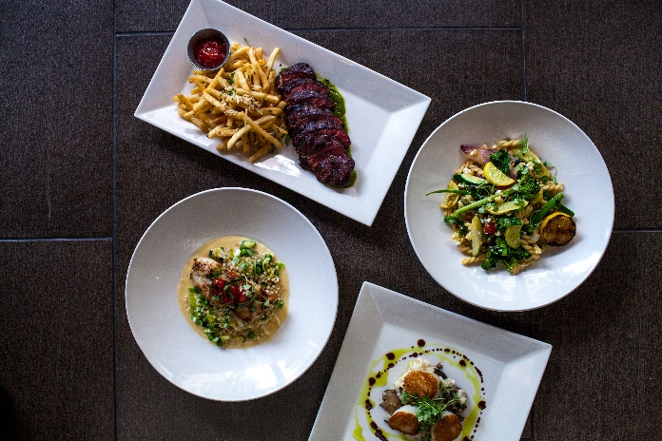
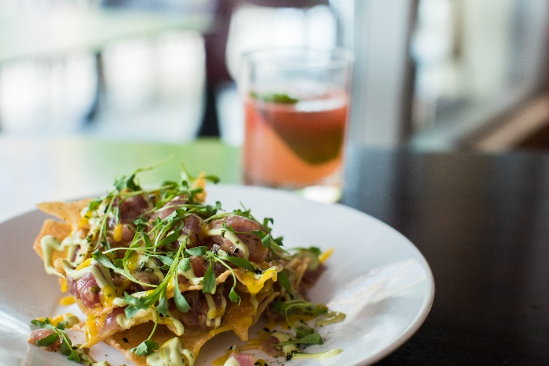
Step 1
What type of party and when? (Date/Time)
Standing cocktail or happy hour event
Sit down dinner
Sit down lunch

Slide 11
Step 2
A
Pick a spot based on party type and size
Patio (up to 150 Standing/30 – 55 Seated)
Hightops (up to 40 standing/14 seated)
Main Dining Room (up to 12 seated)
B
C

Slide 12
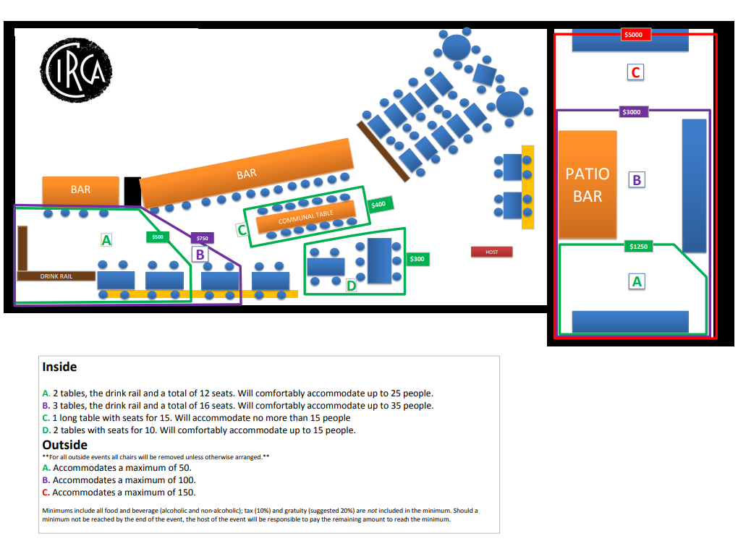
Refer to our pricing guide

Slide 13
Step 3
Pre-select Menu based on budget and preference
Pre-set Dinner/Lunch Menus
Pre-set Platters
Pre-set Passables
Pre-Selected Wines
Special Requests
Step 4
Close Contract Details
Patio (up to 150 Standing/ 30 - 55 Seated)
Hightops (up to 40 standing/ 27 seated)
Main Dining Room (up to 12 seated)

Slide 14
FAQ’s
What is the next step?
Send us an email at https://event.circabistros.com/ and click on “Inquire Now” under our Circa at Foggy Bottom location. Fill in your event details and we will get back to you to help you plan your event!
What is your Large Party “Minimum Spend” Policy? Given the fluid nature of the restaurant business we try to keep accurate and flexible minimums. Our minimums will reflect anticipated business on the day or night of your event and the space that you are choosing to utilize. Therefore, if you’re looking for main dining area on a Saturday during peak hours your minimum would be very high. On the other hand if your party is able to book off peak hours or dates we can be far more flexible with our minimum spend requirements. We always try our best to work with each and every guest and party that walks in the door. We will work to find a solution to any budget and any timeslot we have available to guarantee the best experiences for all.
Do you have “room fees?” We do not usually have any room fees, rather we have a minimum spend policy. With this arrangement you’re only paying for items you receive as long as you reach the minimum quoted for your party. The only time a room fee would be applied is in the event your party fell short of the minimum spend and chose not to order anything more.
Do you offer gluten free (or other allergen) options on your set menus? Yes! We offer a gluten sensitive menu. We understand that sensitivity to gluten can vary and feel it’s important to note CIRCA is not a gluten free environment. Please let us know any dietary restrictions prior to menu selection and we will do our best to accommodate.
Do you offer Open Bar packages? Yes! We offer 3 different tiers. A beer and wine package, a house package and a premium package.

Slide 15
FAQ’s
Do you have audio and video capabilities in the Private Room? Both the private and semi-private areas have their own television with HDMI ports on the televisions. For any other A/V need (screens, projectors, speakers, microphones) you would need to bring in from an outside source which we can acquire for you.
Can we decorate the space? Depending on the nature of the event guests often inquire about decorations. We are open to outside decorations within reason and just ask that it not interfere with other guests that may be dining in our establishment. We typically try to avoid flashing lights, noise makers or massive balloon arrangements. But, never hesitate to ask and as always we will try to make it work!
Does the minimum spend include tax and gratuity? All quoted minimums do NOT include tax and gratuity.
Can we bring our own cake/desserts? Of course you can! We are more than happy to store it in our fridge while you dine and cut it for you once it’s ready.

Slide 16
FAQ’s
Do you accommodate Tax Exemptions? Yes, we can absolutely accommodate your tax exemption! As long as you provide your valid tax exemption form/card, you will not be charged tax. If you are not Tax Exempt, you will be charged 10% DC tax.
Is the patio comfortable during inclement weather? Our patio is great for dining in all seasons. There are toasty heaters covering the expanse of the patio. It is also protected by an awning and nylon panels that enclose the sides and are retracted during warm weather. In this past year, we had guests dine on the patio nearly every single day. A jacket may be necessary on days that average below 40°F.
What if my party size changes before the event? A guaranteed guest count is due by noon two business days prior to the event date. If the guaranteed guest count is not met, the party will still be charged the minimum spend based on the guaranteed guest count.
What if my party wants to stay after its allotted time slot? We are more than happy to try our best to accommodate your group in the restaurant, but we cannot guarantee the same space for your group beyond the event’s time slot. The space is subject to the needs of the restaurant after this time.
Can I have my guests open individual tabs for my event? You may allow your guests to open individual tabs for the event. Although, these tabs will not be factored into the minimum spend. You are welcome to split the payment over a couple of cards however, in order to track the minimum we require everything to be on one check

